Slide 1
Recurrent Neural Networks (RNN) and Long-Short Term Memory(LSTM)

Slide 2
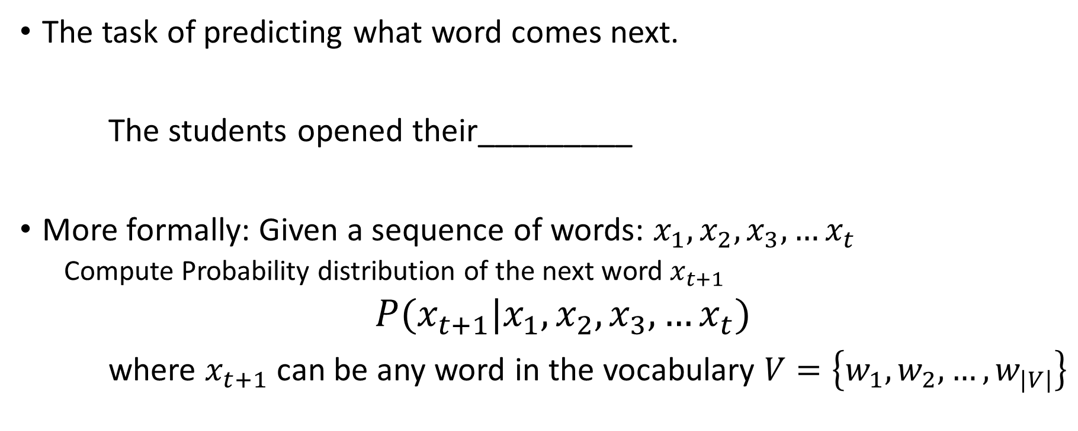
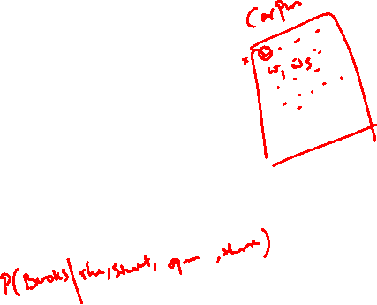
Recap…Language Modelling
The task of predicting what word comes next.
The students opened their_________
More formally: Given a sequence of words: $x_{1},x_{2},x_{3},…x_{t}$
Compute Probability distribution of the next word $x_{t+1}$
$P(x_{t+1}|x_{1},x_{2},x_{3},…x_{t})$
where $x_{t+1}$can be any word in the vocabulary $V=\left\{w_{1},w_{2},…,w_{|V|}\right\}$
Books/
Laptops/
Exams/…

Slide 3
















Recurrent Neural Networks (RNN)
Core idea: Apply the same weights $W$ repeatedly
$$…$$
outputs (optional)
$${\hat{y}}^{\left(1\right)}$$
$${\hat{y}}^{\left(2\right)}$$
$${\hat{y}}^{\left(3\right)}$$
$${\hat{y}}^{\left(4\right)}$$
$$h^{\left(1\right)}$$
$$h^{\left(2\right)}$$
$$h^{\left(3\right)}$$
$$h^{\left(4\right)}$$
W
W
W
W
hidden states
$$…$$
$$…$$
input sequence (any length)
$$x^{\left(1\right)}$$
$$x^{\left(2\right)}$$
$$x^{\left(3\right)}$$
$$x^{(4)}$$

Slide 4









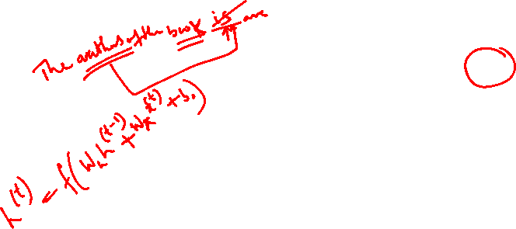



Why is vanishing gradient a problem?
Vanishing gradient problem:
When these are small, the gradient signal gets smaller and smaller as it backpropagates further
$$J^{\left(t−k\right)}(θ)$$
$$J^{\left(t\right)}(θ)$$
$$h^{\left(0\right)}$$
$$h^{\left(t−2\right)}$$
$$h^{\left(t−1\right)}$$
$$h^{\left(t\right)}$$
W
W
W
W
$$…$$
$$x^{\left(1\right)}$$
$$x^{\left(2\right)}$$
$$x^{\left(3\right)}$$
$$x^{(4)}$$
$$…$$
Gradient signal from faraway is lost because it’s much smaller than gradient signal from close-by.
So model weights are updated only with respect to near effects, not long-term effects.

Slide 5
Why is vanishing gradient a problem?
Gradient can be viewed as a measure of the effect of the past on the future
If the gradient becomes vanishingly small over longer distances (step t to step t+n), then we can’t tell whether:
There’s no dependency between step t and t+n in the data
We have wrong parameters to capture the true dependency between t and t+n

Slide 6
How to fix vanishing gradient problem?
The main problem is that it’s too difficult for the RNN to learn to preserve information over many timesteps
In a vanilla RNN, the hidden state is constantly being rewritten
How about a RNN with separate memory?

Slide 7
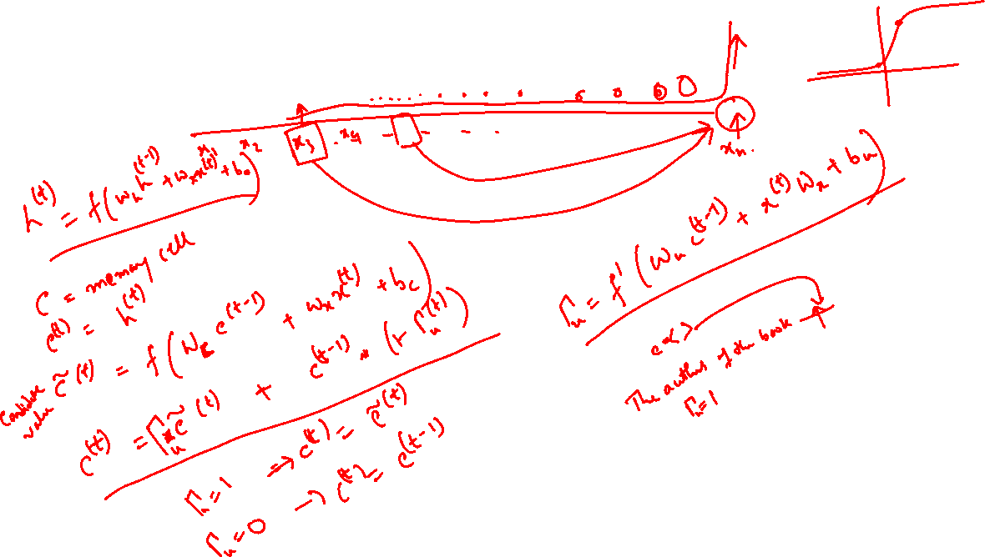
Gated Recurrent Unit (GRU)

Slide 8
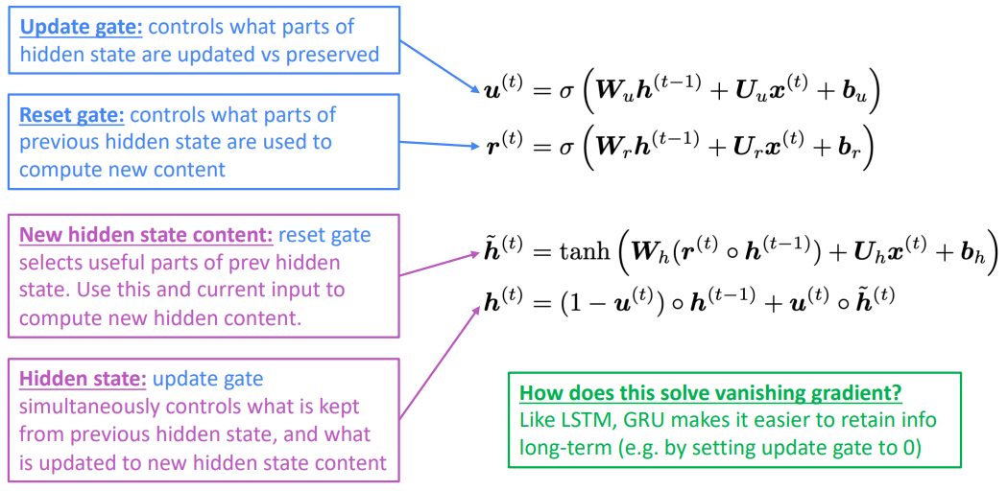
Gated Recurrent Units (GRU)
Proposed by Cho et al. in 2014 as a simpler alternative to the LSTM.
On each timestep t we have input and hidden state (no cell state).

Slide 9
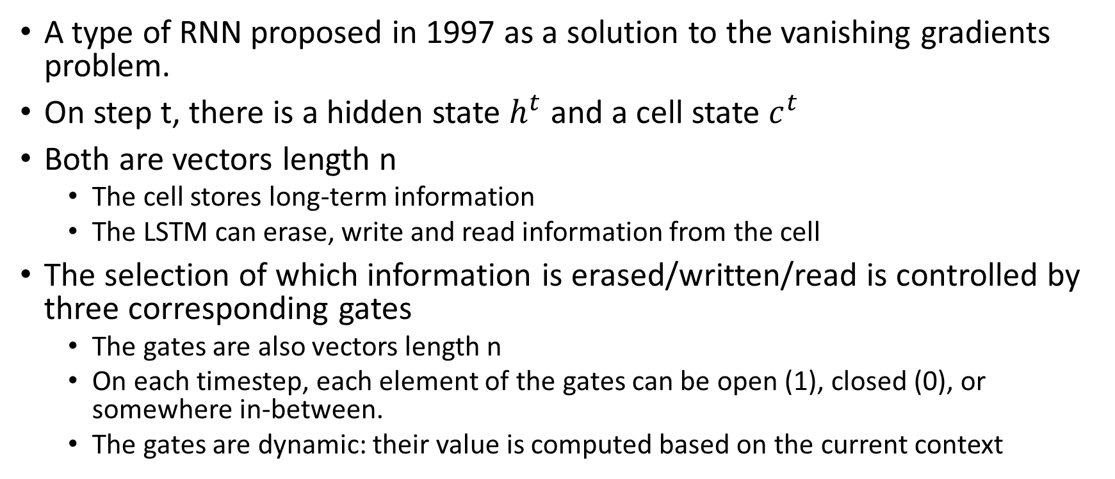
Long Short-Term Memory (LSTM)
A type of RNN proposed in 1997 as a solution to the vanishing gradients problem.
On step t, there is a hidden state $h^{t}$ and a cell state $c^{t}$
Both are vectors length n
The cell stores long-term information
The LSTM can erase, write and read information from the cell
The selection of which information is erased/written/read is controlled by three corresponding gates
The gates are also vectors length n
On each timestep, each element of the gates can be open (1), closed (0), or somewhere in-between.
The gates are dynamic: their value is computed based on the current context

Slide 10




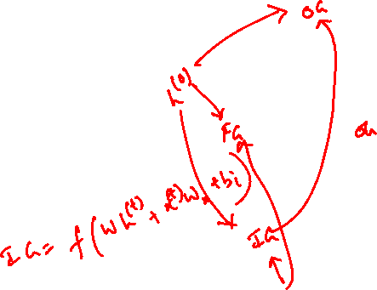


LSTM Intuition
$$…$$
outputs (optional)
$${\hat{y}}^{\left(1\right)}$$
$${\hat{y}}^{\left(2\right)}$$
$${\hat{y}}^{\left(3\right)}$$
$${\hat{y}}^{\left(4\right)}$$
$$h^{\left(0\right)}$$
W
$$h^{\left(2\right)}$$
W
$$h^{\left(3\right)}$$
W
$$h^{\left(4\right)}$$
W
hidden states
$$…$$
$$…$$
input sequence (any length)
$$x^{\left(1\right)}$$
$$x^{\left(2\right)}$$
$$x^{\left(3\right)}$$
$$x^{(4)}$$

Slide 11
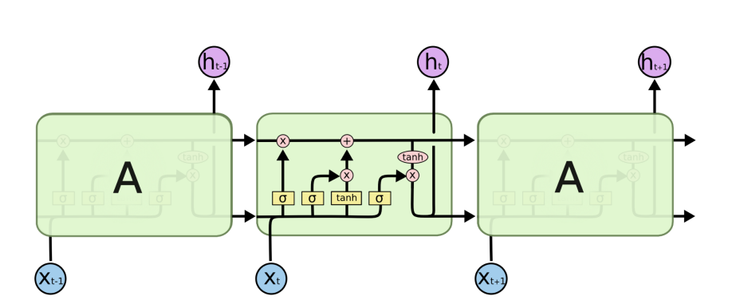
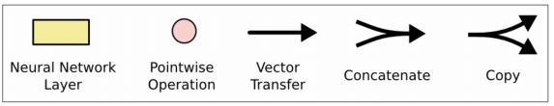
Long Short-Term Memory (LSTM)
You can think of the LSTM equations visually like this:

Slide 12
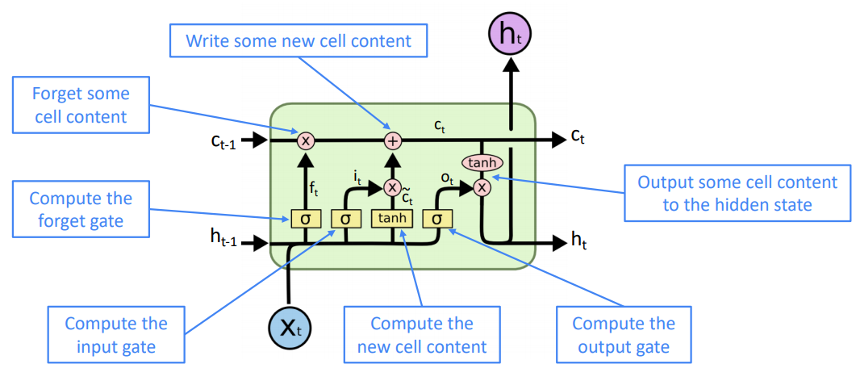
Long Short-Term Memory (LSTM)

Slide 13
How does LSTM solve vanishing gradients?
The LSTM architecture makes it easier for the RNN to preserve information over many timesteps
e.g. if the forget gate is set to 1 for a cell dimension and the input gate set to 0, then the information of that cell is preserved indefinitely.
By contrast, it’s harder for vanilla RNN to learn a recurrent weight matrix Wh that preserves info in hidden state
LSTM doesn’t guarantee that there is no vanishing/exploding gradient, but it does provide an easier way for the model to learn long-distance dependencies

Slide 14
LSTM vs GRU
Researchers have proposed many gated RNN variants, but LSTM and GRU are the most widely-used
Rule of thumb: LSTM is a good default choice (especially if your data has particularly long dependencies, or you have lots of training data); Switch to GRUs for speed and fewer parameters.

Slide 15
Is vanishing/exploding gradient just a RNN problem?
No! It can be a problem for all neural architectures (including feed-forward and convolutional), especially deep ones.
Due to chain rule / choice of nonlinearity function, gradient can become vanishingly small as it backpropagates
Thus lower layers are learnt very slowly (hard to train)
Solution: lots of new deep feedforward/convolutional architectures that add more direct connections (thus allowing the gradient to flow)

Slide 16
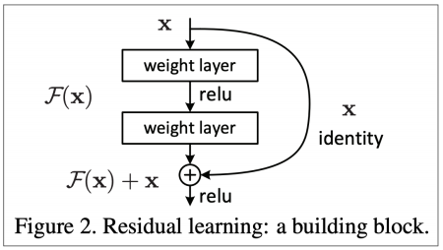
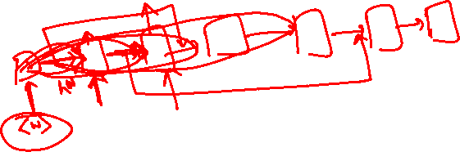
Is vanishing/exploding gradient just a RNN problem?
Residual connections aka “ResNet”
Also known as skip-connections
The identity connection preserves information by default
This makes deep networks much easier to train

Slide 17
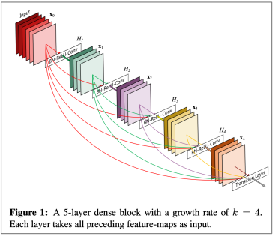
Is vanishing/exploding gradient just a RNN problem?
Dense connections aka “DenseNet”
Directly connect each layer to all future layers!
Highway connections aka “HighwayNet”
Similar to residual connections, but the identity connection vs the transformation layer is controlled by a dynamic gate
Inspired by LSTMs, but applied to deep feedforward/convolutional networks

Slide 18
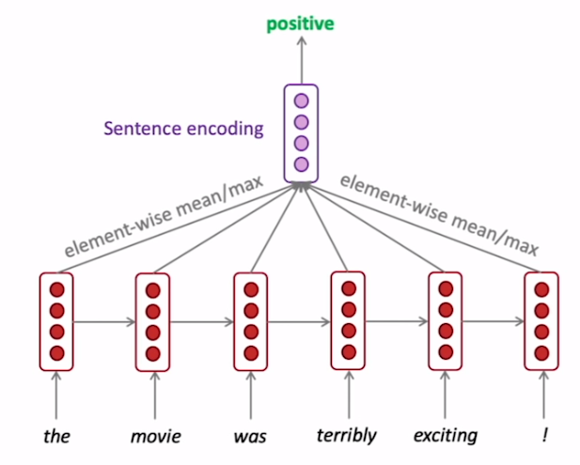
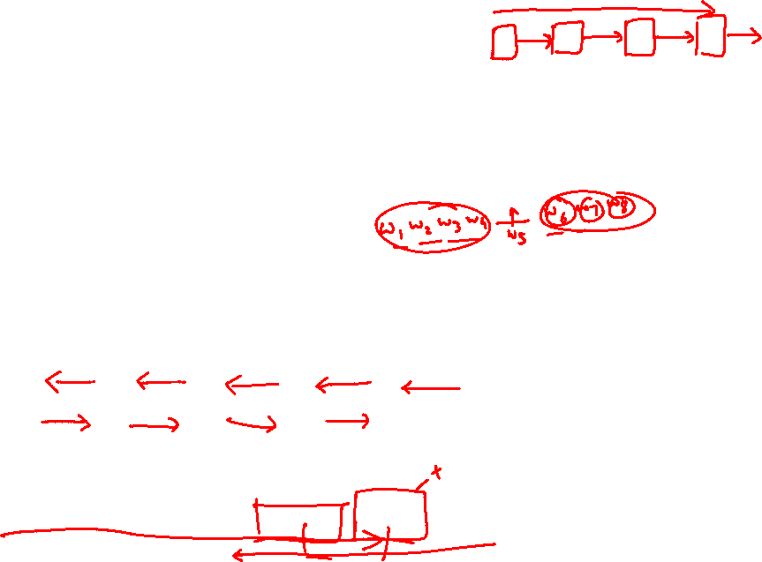
Bi-Directional RNN
We can regard this hidden state as a representation of the word “terribly” in the context of this sentence. We call this a contextual representation.
These contextual representations only contain information about the left context (e.g. “the movie was”).
What about right context?
In this example, “exciting” is in the right context and this modifies the meaning of “terribly” (from negative to positive)

Slide 19
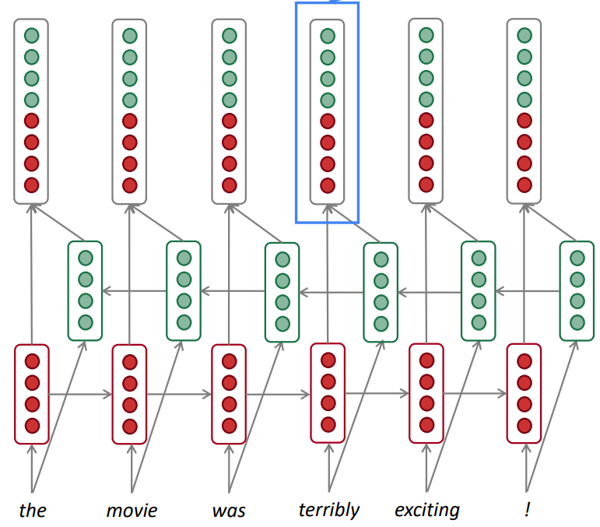
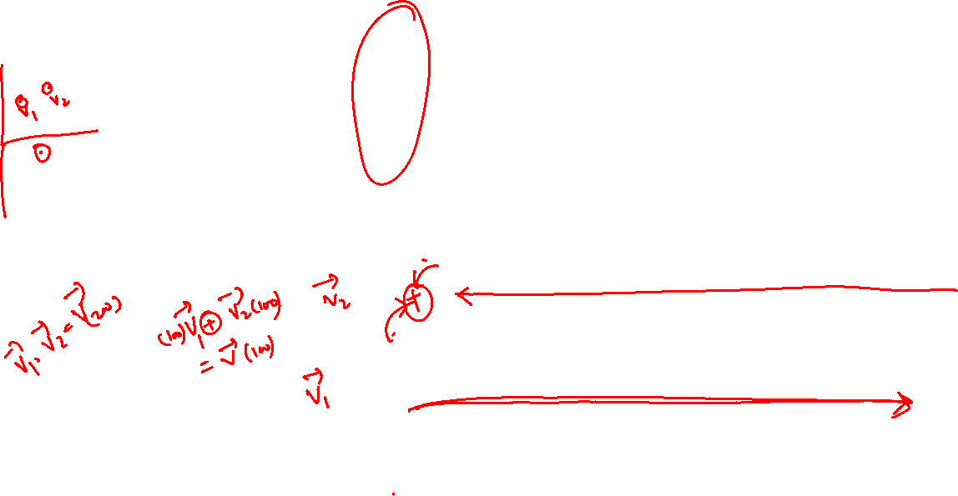
Bi-Directional RNN
Concatenated hidden states
This contextual representation of “terribly” has both left and right context!
Backward RNN
Forward RNN

Slide 20
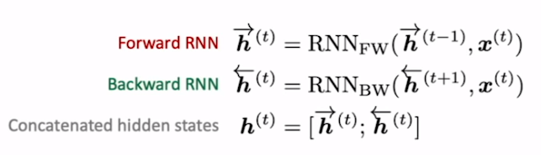
Bidirectional RNNs
This is a general notation to mean “compute one forward step of the RNN” – it could be a vanilla, LSTM or GRU computation.
On timestep t:
Generally, these two RNNs have separate weights
We regard this as “the hidden state” of a bidirectional RNN. This is what we pass on to the next parts of the network.

Slide 21

Bidirectional RNNs
Only applicable if you have access to the entire input sequence.
They are not applicable to Language Modeling, because in LM you only have left context available.
If you do have entire input sequence (e.g. any kind of encoding), bidirectionality is powerful (you should use it by default).
For example, BERT (Bidirectional Encoder Representations from Transformers) is a powerful pretrained contextual representation system built on bidirectionality. • You will learn more about BERT later in the course!

Slide 22
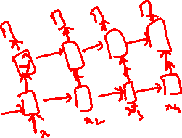
Multi-layer RNNs
RNNs are already “deep” on one dimension (they unroll over many timesteps)
We can also make them “deep” in another dimension by applying multiple RNNs – this is a multi-layer RNN.
This allows the network to compute more complex representations
The lower RNNs should compute lower-level features and the higher RNNs should compute higher-level features.
Multi-layer RNNs are also called stacked RNNs.

Slide 23
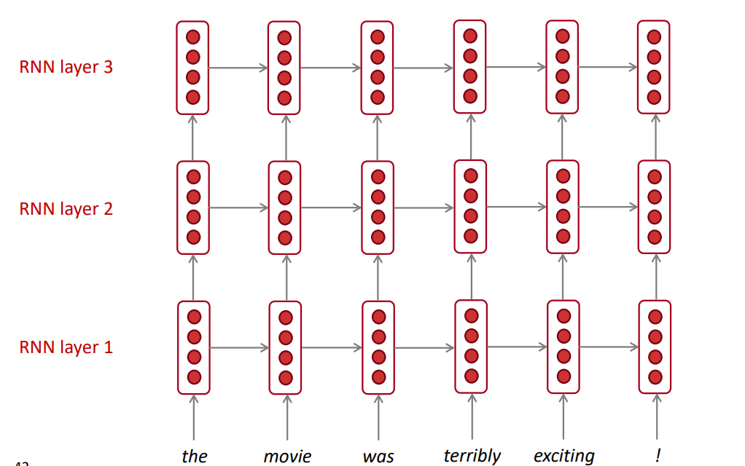
Multi-layer RNNs
The hidden states from RNN layer i are the inputs to RNN layer i+1

Slide 24
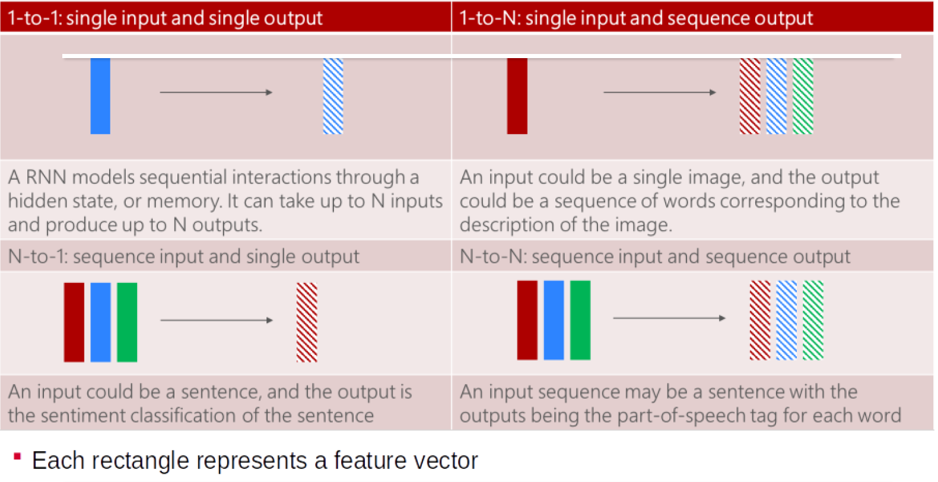
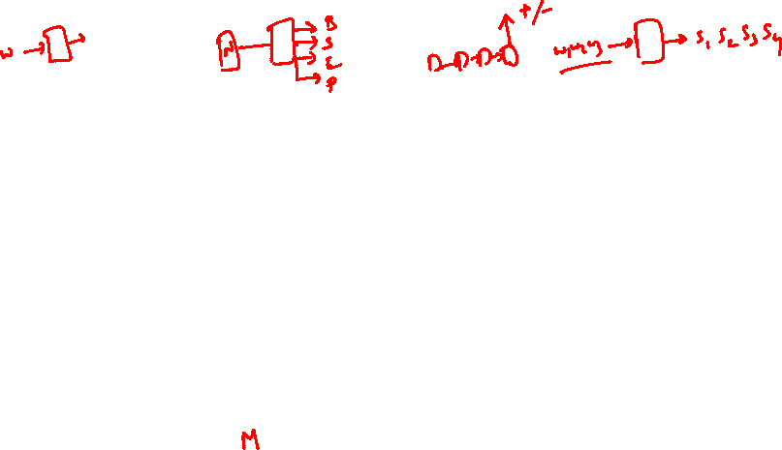
Types of RNN

Slide 25
What is NER ?
NER involves identification of proper names in texts, and classification into a set of predefined categories of interest.
Three universally accepted categories:
Person, location and organisation
Other common tasks: recognition of date/time expressions, measures (percent, money, weight etc), email addresses etc.
Other domain-specific entities: names of Drugs, Genes, medical conditions, names of ships, bibliographic references etc.

Slide 26
NER Definition
Named entity recognition (NER) (also known as entity identification (EI) and entity extraction) is the task that locate and classify atomic elements in text into predefined categories such as the names of persons, organizations, locations, expressions of times, quantities, monetary values, percentages, etc.
John sold 5 companies in 2002.
An episode of subacute encephalopathy after the infusion of a moderate dose of methotrexate (1500 mg/m2) (MTX) is reported in a young adult with metastastic gastric cancer.
The new quinolone derivatives (levofloxacin, sparfloxacin, grepafloxacin, trovafloxacin, gatifloxacin and moxifloxacin), also called gyrase inhibitors, are known for their potential to cause central nervous system-related adverse effects, including headache, dizziness and insomnia.

Slide 27
EXAMPLES for Named Entity and not a Named Entity
Hotel & Taj Hotel
Flower & Rose Flower
Beach & Kovalam Beach
Airport & Indira Gandhi International airport
The School & Good Shepherd School
Prime Minister & Mr. Manmohan Singh

Slide 28
Some problems in indentifying NE
Variation of NEs.
Manmohan Singh, Manmohan, Dr. Manmohan Singh
Ambiguity of NE types:
1945 (date vs. time)
Washington (location vs. person)
May (person vs. month)
Tata (person vs. organization)

Slide 29
Ambiguity Examples
Person vs Location
Sir C. P Ramaswamy was the Divan of Travancore (Per)
Sir C.P Ramaswamy Road is in Chennai (Loc)
Person vs Organization
Anil Ambani opened Reliance Fresh (Per)
Reliance Fresh is under Anil Amabani Group Ltd (Org)

Slide 30
More complex problems in NER
Issues of style, structure, domain, genre etc.
Punctuation, spelling, spacing, formatting, ….all have an impact
Dept. of Computing and Information Science
Manchester Metropolitan University
Manchester
United Kingdom
The Modi Government
> Tell me more about Leonardo
> Da Vinci

Slide 31
Why do NER?
Key part of Information Extraction system
Robust handling of proper names essential for many applications such as Summarization, IR, Anaphora,.........
Pre-processing for different classification levels
Information filtering
Information linking

Slide 32
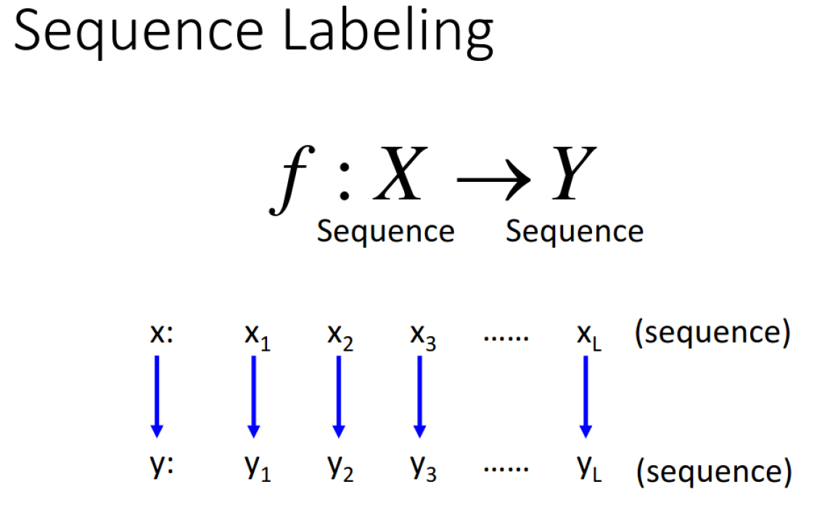

Slide 33
Identify the Person Name
what movies starred both al pacino and robert Ideniro
O what O movies O starred O both B-ACTOR al I-ACTOR pacino O and B-ACTOR robert ACTOR-Ideniro

Slide 34
Example Annotation
O what O movies O star O bruce I-ACTOR willis
O show O mestar B-ACTOR O films O with B-ACTOR drew I-ACTOR barrymore O from O the B-YEAR 1980s
O find O me O all O of O the O movies O that O starred B-ACTOR harold I-ACTOR ramis O and B-ACTOR bill I-ACTOR murray
O find O me O a O movie O with O a O quote O about O baseball O in O it
O what O movies O have B-TITLE mississippi O in O the O title

Slide 35
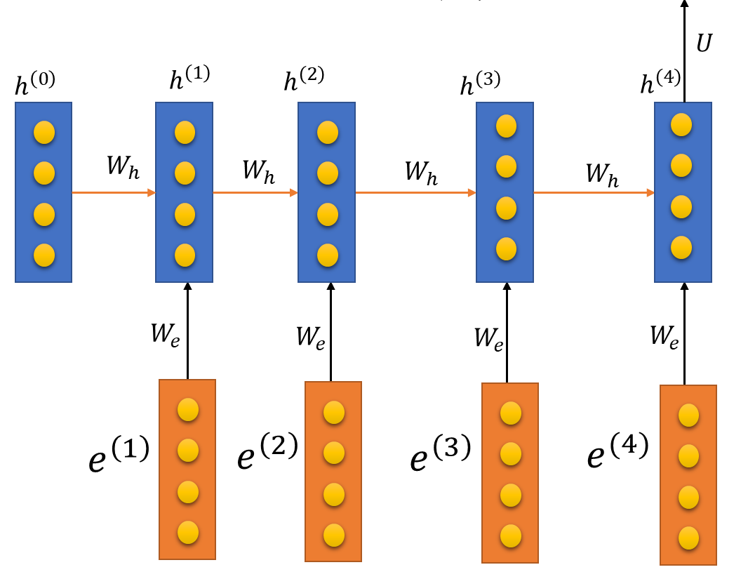









LSTM model for NER Recognition
o o o B-ACTOR I-ACTOR
$${\hat{y}}^{(1)}$$
$${\hat{y}}^{(2)}$$
$${\hat{y}}^{(3)}$$
$${\hat{y}}^{(4)}$$
$${\hat{y}}^{(5)}$$
$$σ$$
$$σ$$
$$σ$$
$$σ$$
Dense
Dense
Dense
Dense
Dropout
Dropout
Dropout
Dropout
…
…
What movies star Bruce Willis

Slide 36









Bi-LSTM model for NER Recognition
PN o o o FN
$${\hat{y}}^{(1)}$$
$${\hat{y}}^{(2)}$$
$${\hat{y}}^{(3)}$$
$${\hat{y}}^{(4)}$$
$${\hat{y}}^{(5)}$$
The best time to visit is during May when you can see both the red Rhododendrons as well as the snow, it is also considered as a holy month.
Rose rose to put rows of roses.
I met Paris at Paris
John Hopkins University
$$σ$$
$$σ$$
$$σ$$
$$σ$$
Dense
Dense
Dense
Dense
Dropout
Dropout
Dropout
Dropout
…
…
Rose rose to put rows of roses.

Slide 37
Limitations of LSTM
Long range dependency
Vanishing gradient still a problem
Large # of training steps
Recurrence prevents parallel computations

Slide 38
Attention Model Motivation
I have bought and returned three of these units now. Each one has been defective, and finally I just gave up on returning the system. The DVD player constantly gives "Bad Disc" errors and skips if there is even the slightest smudge on a disc. The sound quality is very nice for the price, but since the player doesn't work, it's essentially useless. This is a complete rip-off at any price point

Slide 39
Attention Model Motivation
I have bought and returned three of these units now. Each one has been defective, and finally I just gave up on returning the system. The DVD player constantly gives "Bad Disc" errors and skips if there is even the slightest smudge on a disc. The sound quality is very nice for the price, but since the player doesn't work, it's essentially useless. This is a complete rip-off at any price point
NER Problem
The best time to visit is during May when you can see both the red Rhododendrons as well as the snow, it is also considered as a holy month.

Slide 40






Attention Model
$$h^{(0)}$$
$$x^{(1)}$$
$$x^{(2)}$$
$$x^{(3)}$$
$$x^{(4)}$$
$$x^{(5)}$$

Slide 41

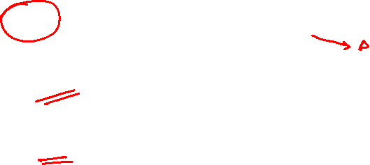







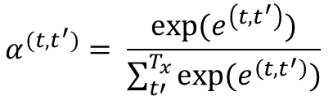

Attention Model
$$α^{(t,t^{′})}=amount of attention y^{(t)} should pay to h^{(t^{′})}$$
$$α^{(t,t^{′})}= \frac{exp⁡(e^{\left(t,t^{′}\right)})}{\sum_{t′}^{T_{x}}{exp⁡(e^{\left(t,t^{′}\right)})}}$$
$${\hat{y}}^{(t−1)}$$
$${\hat{y}}^{(t)}$$
$$S^{(t−1)}$$
$$S^{(t)}$$
$$s^{(t−1)}$$
$$e^{(t,t^{′})}$$
+
$$h^{(t′)}$$
$$h^{(0)}$$
$$x^{(1)}$$
$$x^{(2)}$$
$$x^{(3)}$$
$$x^{(t−1)}$$
$$x^{(t)}$$

Slide 42
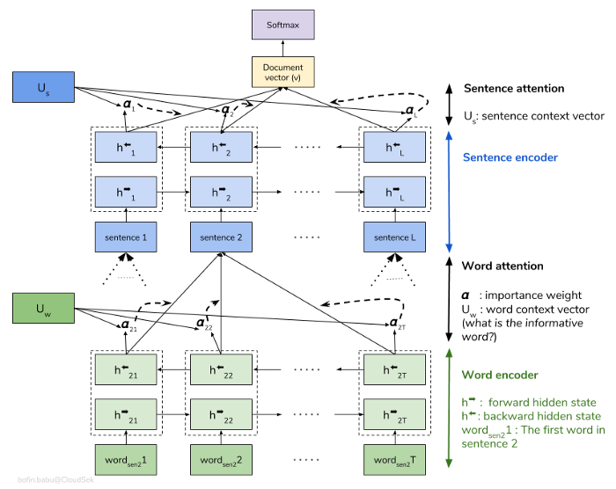
Hierarchical Attention Network (HAN)
Words make sentences and sentences make documents

Slide 43
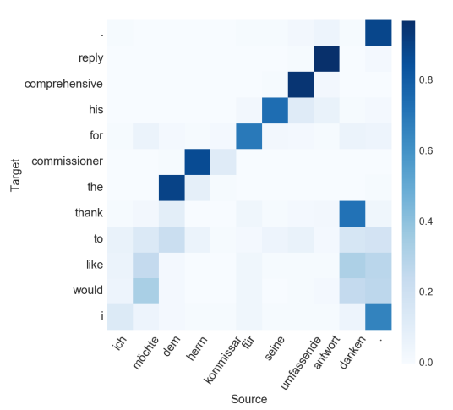

Attention Visualization
Machine Translation
Sentiment Classification

